Slide 1
Lesson Overview
3 min STOP & THINK
5 min recap- what did we figure out (fish are suffocating) and what questions do we still have– this is a recap from last lesson, keep brief
20min – New resources and revising models (looking at new resources and revising models)- use new resources to figure out why the dissolved air is low
3min Demo on making evidence from resources- reminds students how to make evidence from a resource in MEME
7min- discussion on evidence descriptions- how can we describe evidence well– some examples and brief discussion
10 min- back to MEME to make evidence from the resources
7min- discussion of connections between evidence and models– how can we describe connections between evidence and models (evidence supports, strongly supports, contradicts, is irrelevant).
7min- go back to MEME and connect evidence to models
3min BEFORE YOU GO (can be moved after step 6 or 7 if needed)
Notes:
The current plan above is more than 50 min. If things go faster than anticipated, then maybe we can do it in one period. However, let’s not rush discussions too much. If we need to, we can always cut the lesson after they go back to MEME to make evidence (step 6) and continue with the discussion of connections the next day. OR we can cut the lesson after the discussion of connections (step 7) and continue with them connecting evidence to the model the next day.
Regardless, go to the BEFORE YOU GO with 3 min left in the period. Let’s get that in.

Slide 2
STOP & THINK!
Grab handout 1 and put your name and information on the top of the first page.
Complete the STOP & THINK! question on the first page.
What kind of evidence would help you figure out what is happening in Passion Puddle?
Notes:
Use this “Stop & Think” as a do now.
Have students fill out their details (name, class and date) then answer the Stop & Think question on their handout
Do not hold a class discussion at this point. Just let them do the STOP & THINK, maybe solicit a few answers by asking a couple of students to share but keep this brief and quickly and move on.

Slide 3

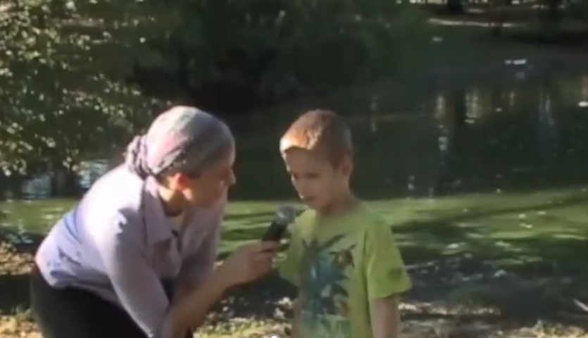

Why Are The Fish Dying?
We made our class model: The fish are suffocating due to low dissolved air
What do we still not know?
Notes:
5min---Briefly review class consensus model → We figured out that fish are suffocating because there isn’t enough dissolved air in the water
Review some major questions on the question board → focus/steer towards the question of WHY this is happening in the first place. Where did the air go?
Whenever possible, ask students to respond to each other rather than to you. This should be about students figuring ideas out together (even in class discussions – redirect students to respond to one another rather than go to you for answers)

Slide 4
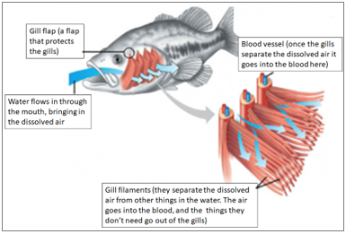
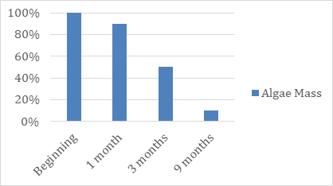
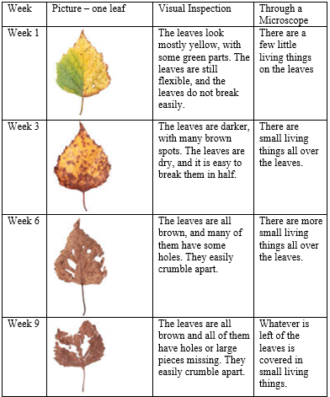
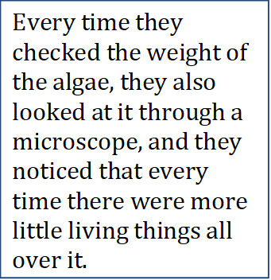
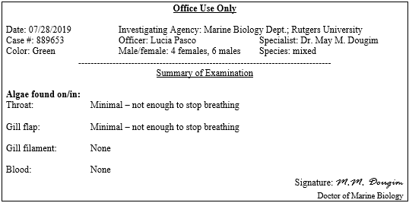
Let’s use evidence to figure out why the fish are suffocating.
With your group, look at three new studies on MEME and answer the questions on handout 1!
Do you need to change your model?
Remember to link evidence to your model!
Resource 4
Resource 5
Resource 6
Notes:
Tell students we now have new evidence in MEME – called Resource 4, 5, and 6 (1, 2, and 3 are the ones they saw previously, and will still be there). They can use these resources to try and figure out why there is low dissolved air.
They need to look at the resources carefully in groups. Answer questions on their handout 1 and decide how they want to change their models to show what new things they learned from these resources.
After they have had a chance to review the resources, we will remind them how to make evidence out of them.
For now, give them about 20min to work with the resources, read them, modify their models and then stop the class and remind them how to make evidence
In order to link a resource to the model they first need to make it into EVIDENCE. The next set of slides reminds them how to do that.

Slide 5
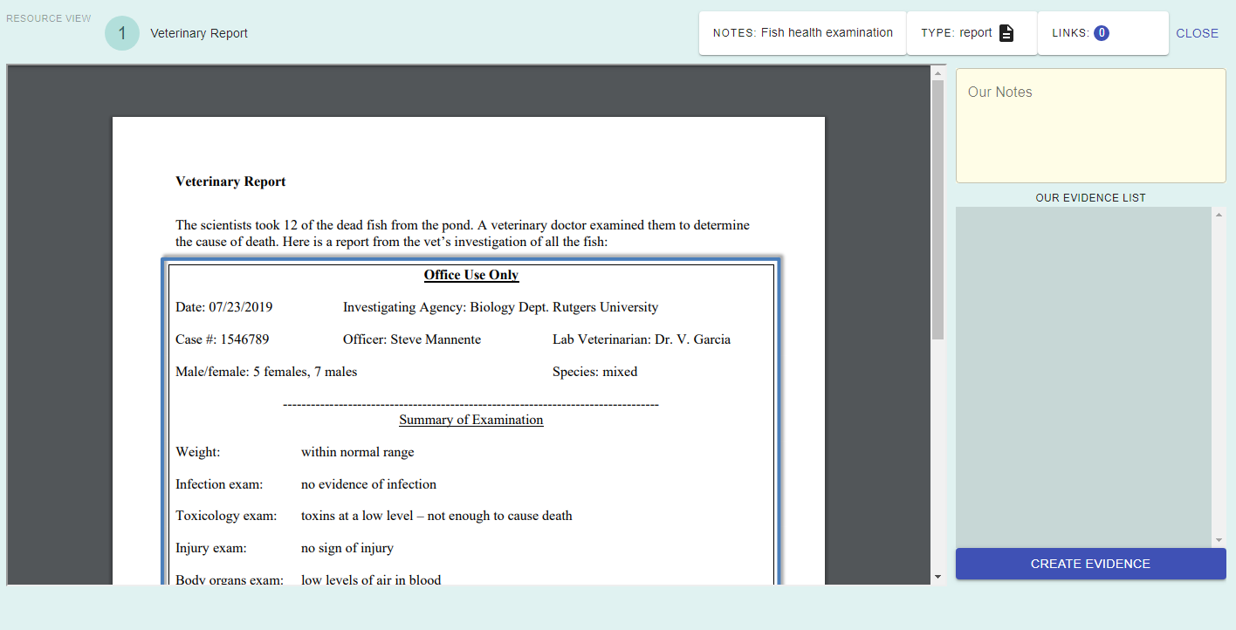
Using the Resources
When we click a resource, we can see lots of things!
Type of resource
Number and name of the resource
Add general notes
Notes:
THIS SLIDE IS ANIMATED
These slides remind students how to make evidence using the resources they saw last lesson. Just review these with the kids. They don’t need to do anything yet (they already made evidence out of these resources last week, we want them to use this knowledge to make new evidence from the new resources today).
Walk students through the basic features, including that they can see the number and name of the resource, what type of resource it is, and general notes.

Slide 6
Supporting with Evidence
When we click a resource, we can see lots of things!
Let’s try.
Did you notice that our evidence list is empty? We haven’t made any evidence yet
Notes:
THIS SLIDE IS ANIMATED
Now we will talk with students about creating evidence.

Slide 7
Supporting with Evidence
When we click a resource, we can see lots of things!
Click here!
Notes:
THIS SLIDE IS ANIMATED
Now we will talk with students about creating evidence.

Slide 8
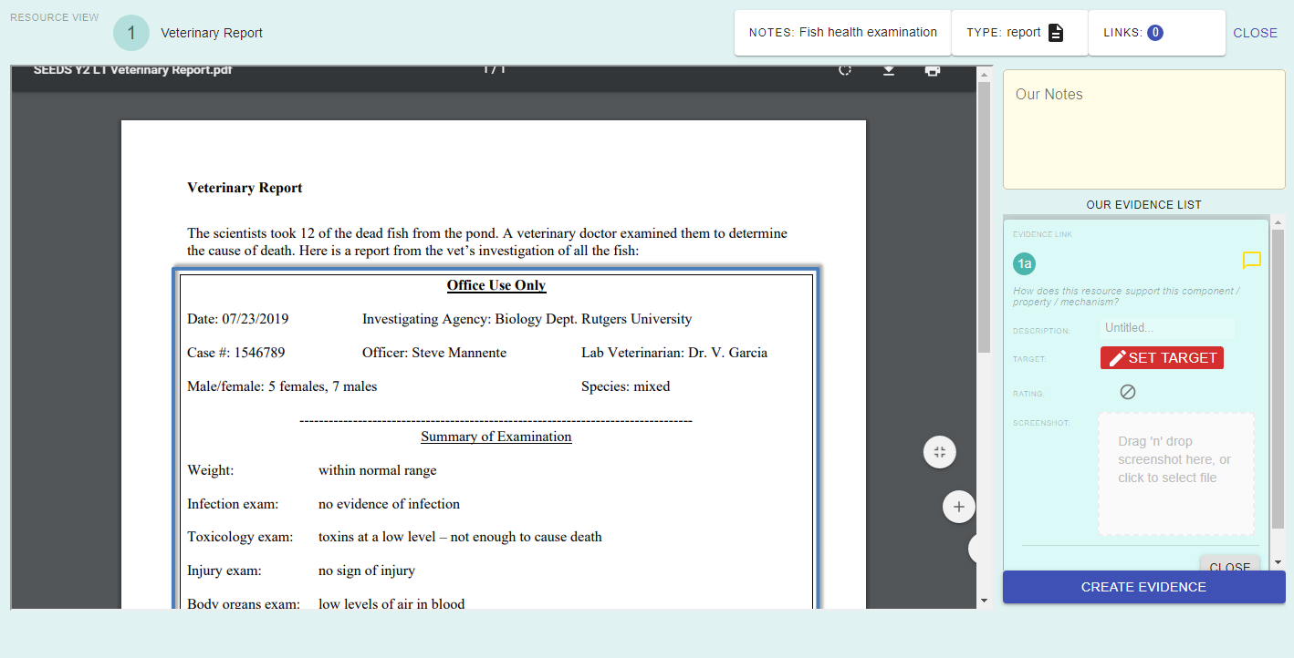
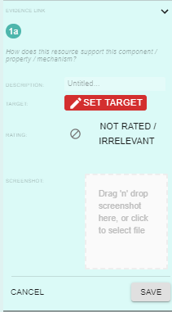
Supporting with Evidence
Describe the evidence
Notes:
This is just a quick run-through of how to make evidence.
In a few slides we will discuss how to best describe evidence. It is very important to describe evidence well! We will get to that soon.

Slide 9
Why is it important to describe evidence? What are good ways to describe evidence?
Notes:
7min –discussion of evidence description-- BEFORE students begin to make evidence out of the new resources have a discussion about how to best describe evidence.
First with their shoulder partner, have them brainstorm what makes for a good description (3min).
Have students share out some of their ideas---
A key point here is that their description should be about what they learned and can conclude from the evidence.
So, for example, describing the evidence as “shows rotten leaves” is not helpful, because we can’t figure out what we can conclude from this evidence.
Ask students for better conclusions
Talk as a class about good ways to describe evidence: “The evidence with the leaves” won’t be helpful once you have a lot of pieces of evidence, and won’t be helpful if you’re just focusing on one part of the resource, such as rotten leaves or if you can’t to use it for different purposes (e.g., if one part of the resource supports one connection and another supports a different connection).
We may talk about this again in the future if students struggle with it, but we want the description to include the “point” of the evidence – e.g., “this evidence shows that there are tiny living organisms” could support “tiny living organisms” being a component, but “this evidence shows that tiny living organisms are increasing as algae disappear“ could support a mechanism between tiny living organisms and algae.
If students have been linking evidence, focus on one resource and ask them what they’ve been connecting it to and what would be a good description. We want the description to get at why the evidence is relevant, and to what.
Whenever possible, ask students to respond to each other rather than to you. We want students to have practice figuring ideas out together (even in class discussions – redirect students to respond to one another rather than go to you for answers).

Slide 10
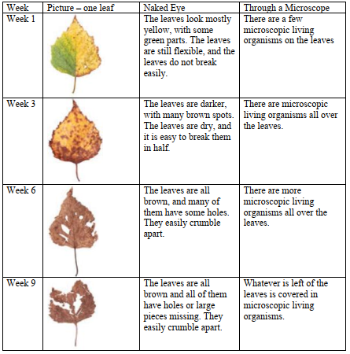
Describing Evidence
What would be a good description for this evidence?
Notes:
Have students brainstorm some description- give them a min to think by themselves
The next slide has some options for the class to consider

Slide 11
Describing Evidence
What would be a good description for this evidence?
How about:
Shows rotting leaves
Leaves have living things on them
Very rotten leaves have more livings things on them. Livings things may be breaking down the leaves.
Which is better and more helpful?
Notes:
Have the class discuss these options, which is best and why.
Students may feel that the last one is too interpretive. If they do, then decide together what would be a better conclusion.
Bottom line the description should help them understand the point of the evidence, and it is OK if it includes some interpretation

Slide 12
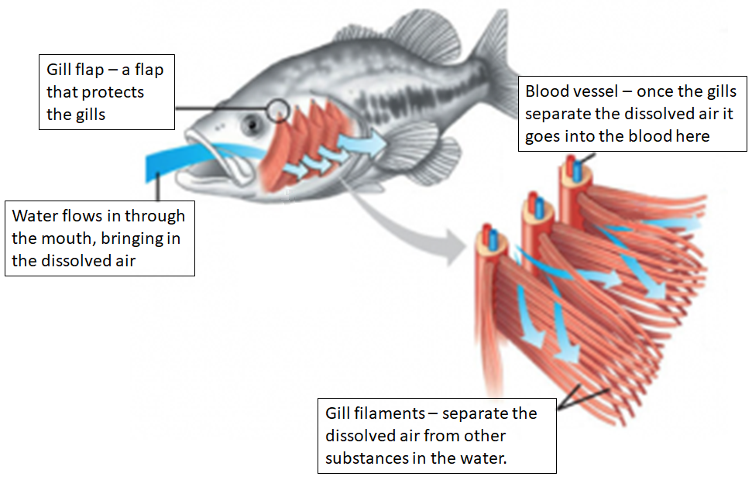
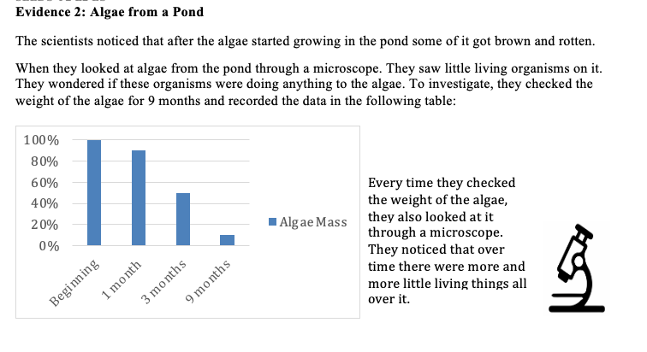
Let’s use evidence to figure out why the fish are suffocating.
With your group, make evidence from these resources. Make sure you write good descriptions!
Resource 4
Resource 5
Resource 6
Notes:
10min– making evidence in MEME from new resources--- Have the kids go back to the MEME environment and make evidence out of the three new resources.
Let kids keep working for ~10 minutes.
Encourage kids to review their evidence descriptions and see if they fit with the links/connections they made.

Slide 13

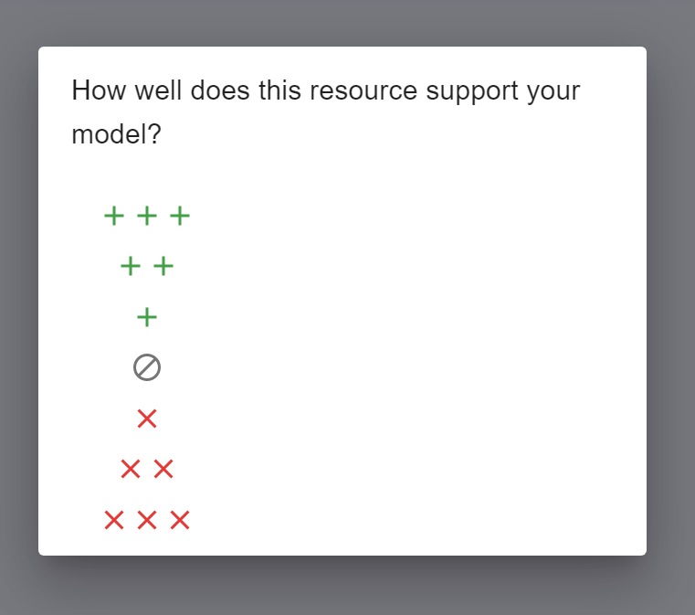
Evidence Discussion
In MEME, we can rate how well a evidence supports our model.
What could these levels mean?
How can evidence connect to a piece of the model?
Notes:
7 min- discussion of evidence-model links
After the kids made evidence with good descriptions they need to link the evidence to the models.
We already showed them that last week. But now we will show them how to use the rating scale when they connect evidence
Regroup the class and have a discussion about the different ways evidence links to models…(see below)
7 min-- Evidence discussion: How can evidence connect to our models?
As a class, discuss how some of the pieces of evidence that students just made might SUPPORT, CONTRADICT, or BE IRRELEVANT to a certain piece of the model
There are examples on the next slide.
At the end of the discussion we want to have some names to go with the plus and x signs. These names should be something the kids make up.
For the plus ones, students might want to name them something like, “Support, really support, SUPER SUPPORT
For the x signs students may want to name them : “contradicts a little, contradicts medium, SUPER CONTRADICTS!”
For the no entry sign, students can name that “Irrelevant” or “Doesn’t even connect”
Students might want to discuss the difference between contradict and irrelevant, and between different levels of support/contradict (e.g., “support” vs. “really support”). Once you decide on the names for the levels we will include them in MEME.
USE the examples on the next slides to drive the discussion
Note: Evidence discussions will become a common routine. Each time we’ll be talking about different features of the evidence

Slide 14
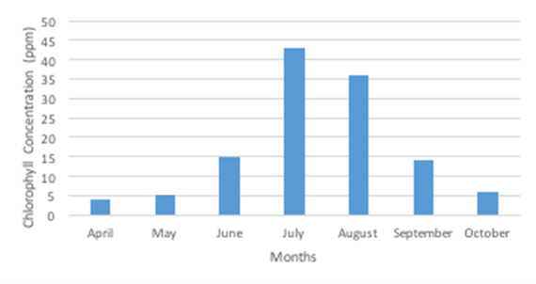
Evidence Discussion
How does the evidence about Pond Chlorophyll support the model below?
There are lots of algae
Algae are getting into the fish’s lungs
Fish do not have enough air
Fish die
Notes:
The model at the bottom is only an example → the students’ models do NOT have to look like this.
This is a piece of evidence from lesson 1. It supports there being lots of algae, but students may say it supports a lot, supports a little, or is irrelevant (because it’s about chlorophyll and not algae). Regardless, encourage students to say: what the connection is (support, irrelevant, etc.), what it connects to (which component or mechanism in the model), and what their reasons are.
e.g., “This evidence supports the part that there is lots of algae because…”
Students can say this in their own words (they don’t have to use “support” specifically)
Have students decide how they want to connect it- do they want one plus, or two pluses, or maybe the no entry… they can develop names for the pluses and X’s as they go along.

Slide 15
Evidence Discussion
How does the evidence about Algae on Fish support the model below?
There are lots of algae
Algae are getting into the fish’s lungs
Fish do not have enough air
Fish die
Notes:
The model picture will be replaced with a picture from MEME.
This is a piece of evidence that students just saw in this lesson. It contradicts the part of the model that says that algae are getting into the fish’s lungs.
Encourage students to say: what the connection is (contradict, highly contradict, etc.), what it connects to (which component or mechanism in the model), and what their reasons are.
e.g., “This evidence goes against the part that the algae are getting into the fish’s lungs because…”
Students can say this in their own words (they don’t have to use “contradict” specifically)

Slide 16
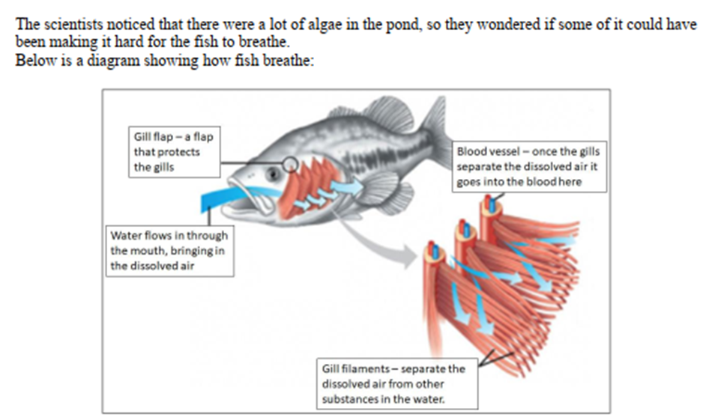
Let’s use evidence to figure out why the fish are suffocating.
With your group, connect the evidence to your model!
Resource 4
Resource 5
Resource 6
Notes:
Have the kids go back to the MEME and connect their newly made evidence to the model.
The next two slides remind them again how to do this.
Give them 7 min to do this.
Then move them to the BEFORE YOU GO and end class.

Slide 17
Supporting with Evidence
Connect to the model
Let’s try!
Notes:
You will be talking later about different ways that evidence can connect to models. For now, you can suggest that it supports a part of the model, and show them how it can connect.

Slide 18
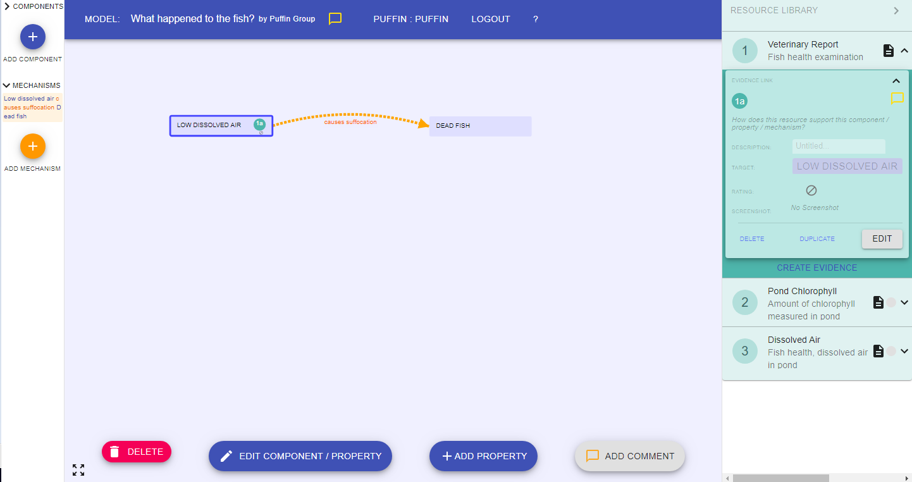


Supporting with Evidence
Now you can see the evidence connected!
And you can see it here
Notes:
THIS SLIDE IS ANIMATED
CONTINUATION OF LAST SLIDE:
You will be talking later about different ways that evidence can connect to models. For now, you can suggest that it supports a part of the model and show them how it can connect.

Slide 19
BEFORE YOU GO
Complete the BEFORE YOU GO questions.
Ramona thinks that her model for why the fish are dying is accurate. Now she sees a new study that does not fit her model. What should she do?
Notes:
END OF DAY 1
Use this “Before You Go” as an exit ticket.
Do not hold a class discussion at this point, and keep it brief at the end of class.

Slide 20
Let’s use evidence to figure out why the fish are suffocating.
Discuss ALL the evidence pieces in pairs and answer the questions individually.
Resource 4
Resource 5
Resource 6
Notes:
These are the evidence pieces in case you need to project them

Slide 21
Notes:
Evidence 1 part 1

Slide 22
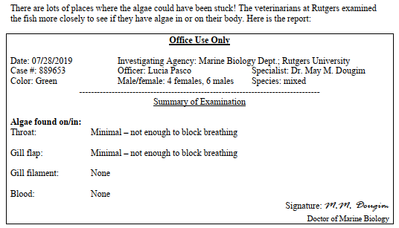
Notes:
Evidence 1 part 2

Slide 23
Notes:
Evidence 2

Slide 24
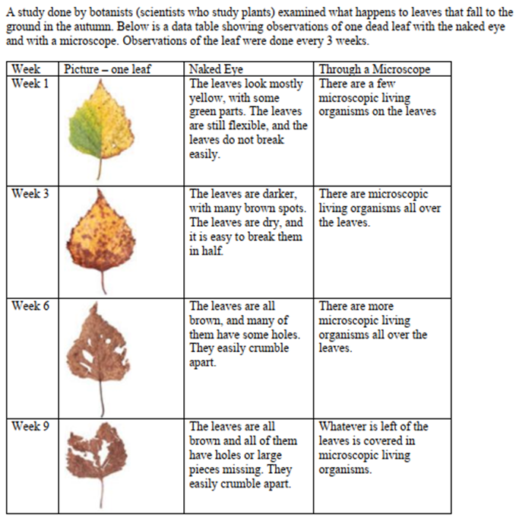
Notes:
Evidence 3

